Slide 1
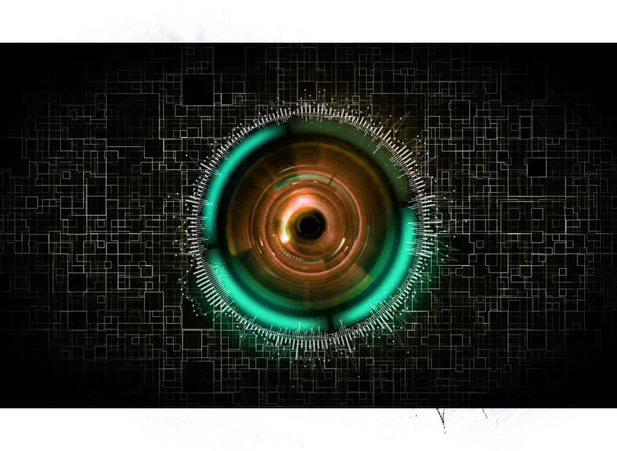
Advanced Deep Learning

Slide 2
Advanced Deep Learning
Convolutional Neural Networks (CNN)
Deep Residual Networks
Auto
Encoders
Generative Adversarial Networks
Transfer Learning
Ek1: CNN

Slide 3
Advanced Deep Learning
Python
Pytorch
Keras

Slide 4
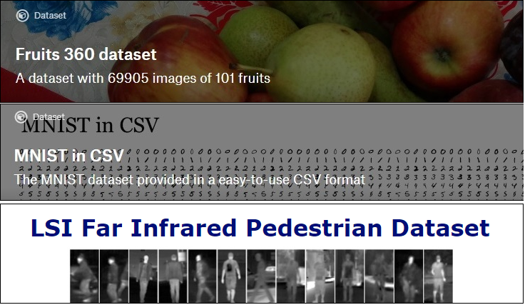
Advanced Deep Learning Projects

Slide 5
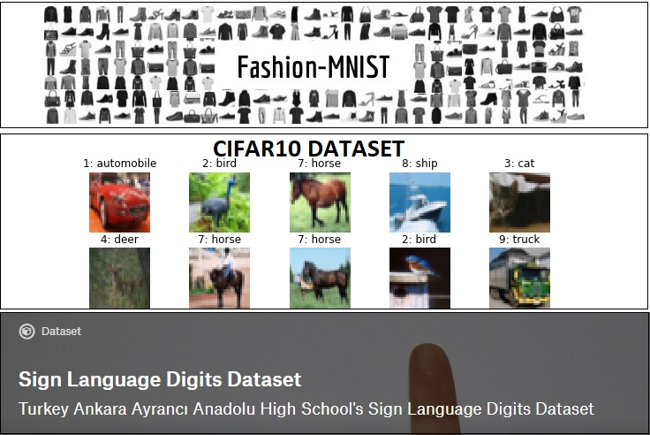
Advanced Deep Learning Projects

Slide 6
Advanced Deep Learning
Kurulumlar:
Anaconda
https://www.anaconda.com/distribution/#download-section
Keras
pip install tensorflow
pip install keras
Pytorch
conda install -c peterjc123 pytorch
OpenCV
conda install -c conda-forge opencv

Slide 7
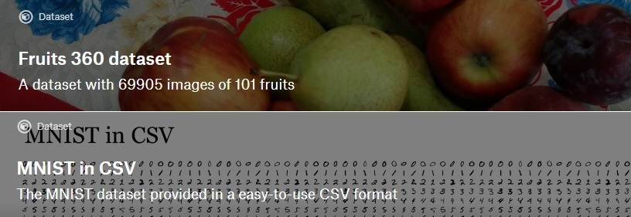
Convolutional Neural Network
Course Prerequisite:
Convolutional Neural Networks basics
EK-1 video
https://www.kaggle.com/kanncaa1/convolutional-neural-network-cnn-tutorial
Content
CNN Review
CNN Review Projects with Python (Keras)
https://www.kaggle.com/oddrationale/mnist-in-csv
https://www.kaggle.com/moltean/fruits
http://scs.ryerson.ca/~aharley/vis/conv/flat.html

Slide 8
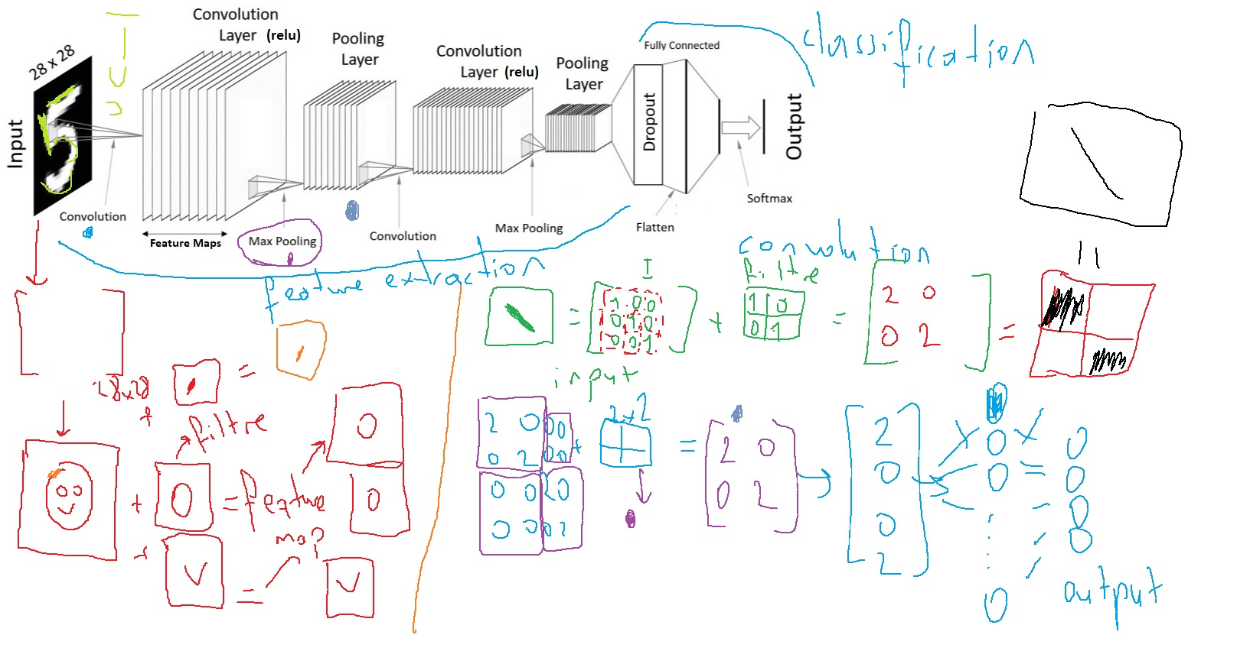
Convolutional Neural Network Review

Slide 9
Deep Residual Networks
Content:
CNN vs Deep Residual Networks
Vanishing Gradient Problem
Deep Residual Networks
Infrared Pedestrian Dataset Description
IR Pedestrian Classification with CNN
IR Pedestrian Classification with Deep Residual Network
CNN Pytorch Tutorial: https://www.kaggle.com/kanncaa1/pytorch-tutorial-for-deep-learning-lovers#5

Slide 10
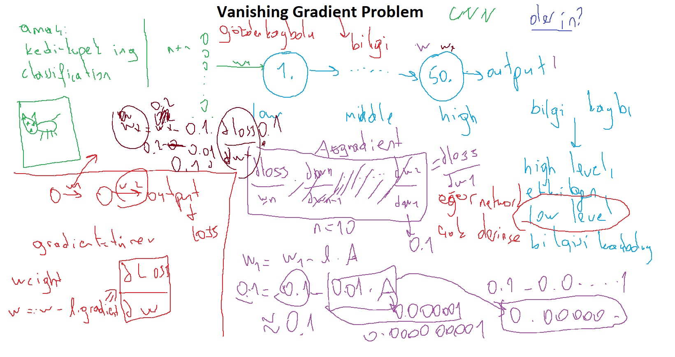
Deep Residual Networks

Slide 11
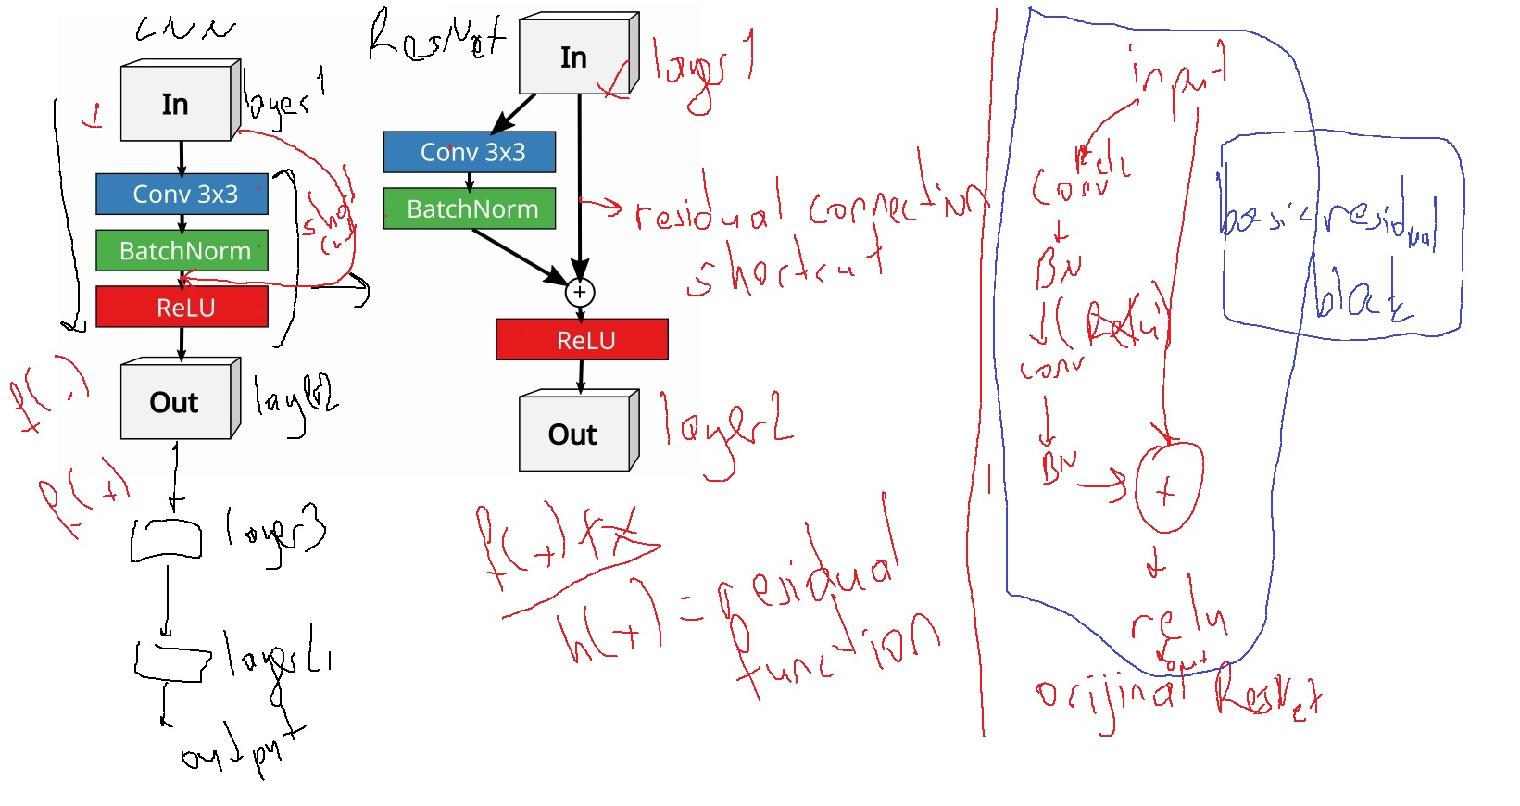
Deep Residual Network

Slide 12
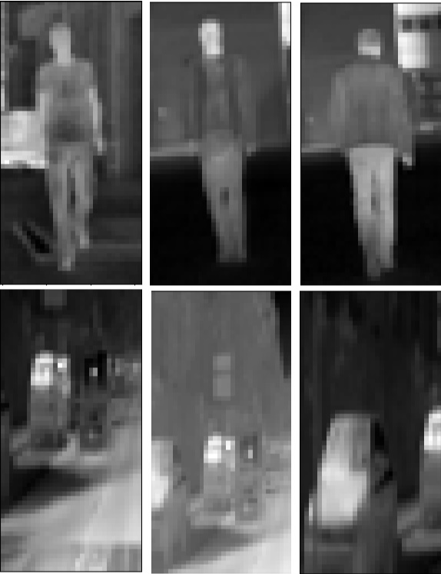
Infrared Pedestrian Dataset Description
 | PEDESTRIAN | NON-PEDESTRIAN
TRAIN | 10208 | 43390
TEST | 5944 | 22050
Dataset: http://portal.uc3m.es/portal/page/portal/dpto_ing_sistemas_automatica/investigacion/Intellige
ntSystemsLab/research/InfraredDataset

Slide 13
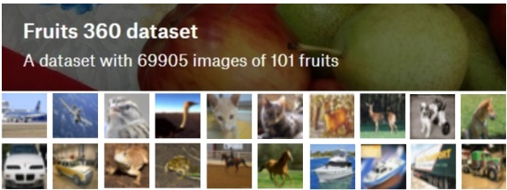
Transfer Learning
Content:
Transfer Learning
Transfer Learning Types
Dataset Desription (Fruits360 – CIFAR10)
VGG16/19 with Python(Keras)
https://www.kaggle.com/moltean/fruits

Slide 14
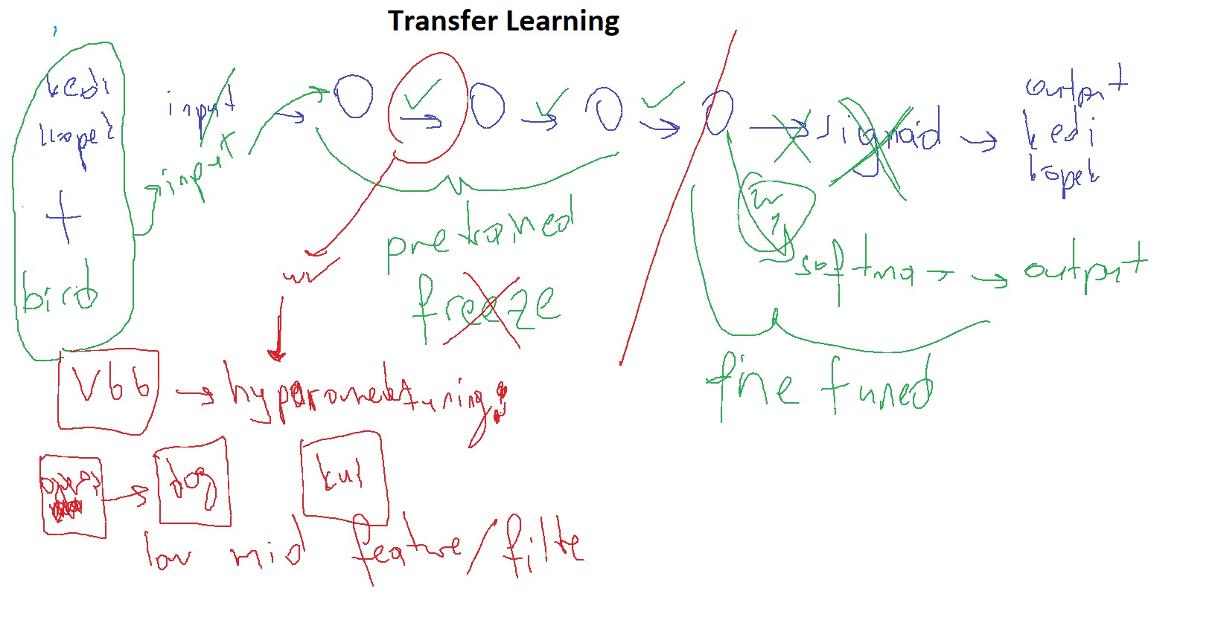
Transfer Learning

Slide 15
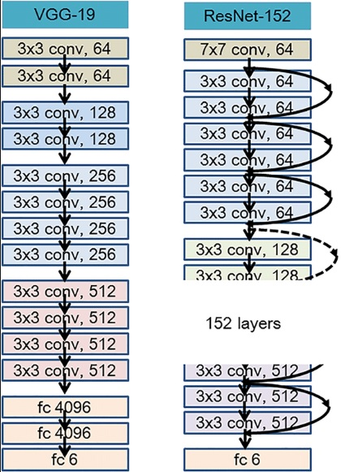
Transfer Learning
VGG & ResNet
ImageNet has more than 14million images.
https://keras.io/applications/

Slide 16
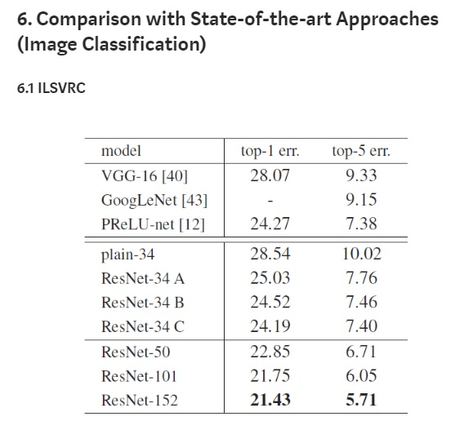
Transfer Learning
VGG & ResNet

Slide 17
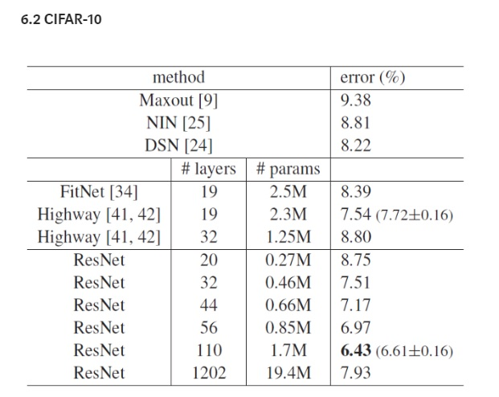
Transfer Learning
VGG & ResNet

Slide 18
Transfer Learning
VGG19
VGG19
CIFAR10
5 epochs yapmanız yeterli ☺

Slide 19
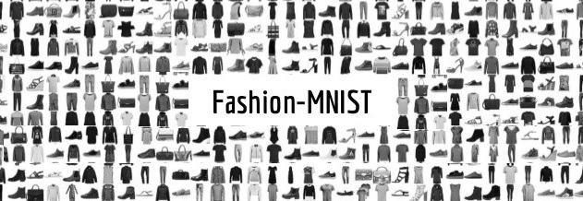
Autoencoders
Content:
Autoencoders
Fashion Mnist dataset
Autoencoders with Python(Keras)

Slide 20
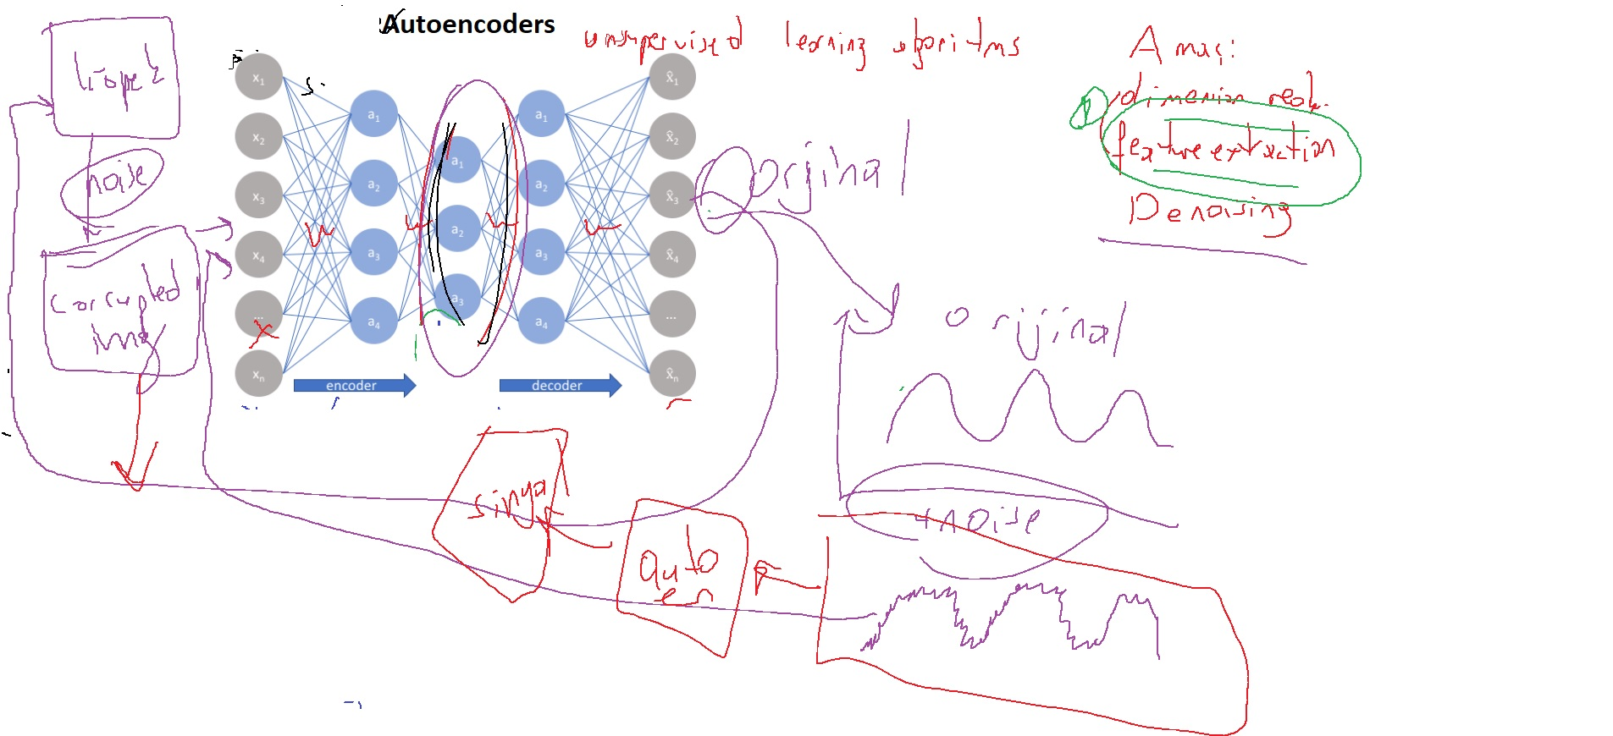
Autoencoders

Slide 21
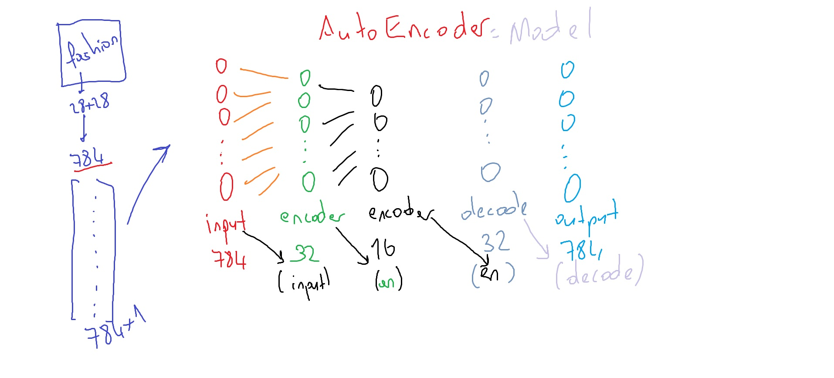
Autoencoders

Slide 22
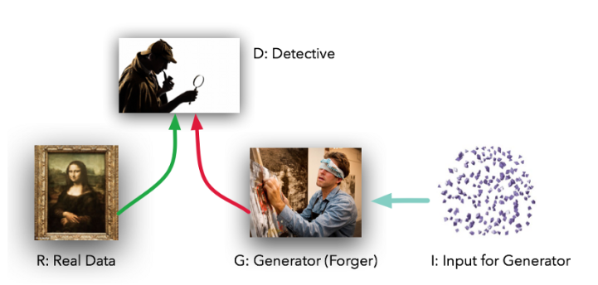
Generative Adversarial Networks (GANs)
Content:
GANs?
GANs Applications
GANs with Python (MNIST)

Slide 23
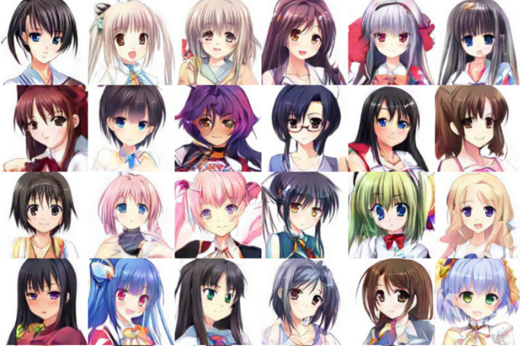
Generative Adversarial Networks (GANs)
https://arxiv.org/pdf/1708.05509.pdf

Slide 24
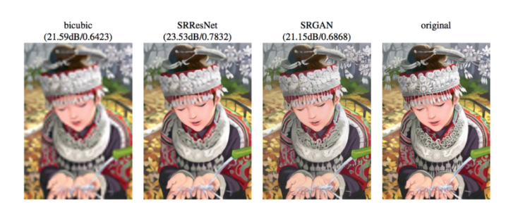
Generative Adversarial Networks (GANs)
https://arxiv.org/pdf/1609.04802.pdf

Slide 25
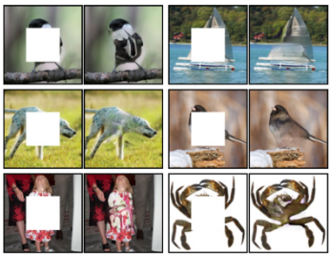
Generative Adversarial Networks (GANs)
https://github.com/pathak22/context-encoder

Slide 26
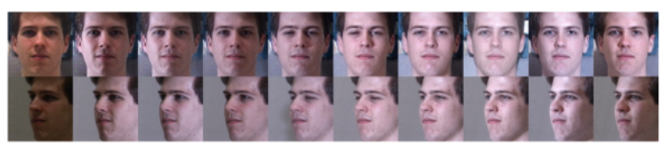
Generative Adversarial Networks (GANs)
https://arxiv.org/pdf/1704.04086.pdf

Slide 27
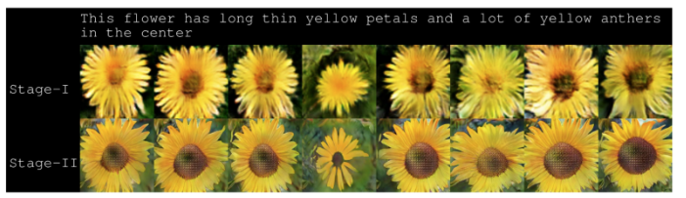
Generative Adversarial Networks (GANs)
https://github.com/hanzhanggit/StackGAN

Slide 28
Advanced Deep Learning
Convolutional Neural Networks (CNN)
Deep Residual Networks
Auto
Encoders
Generative Adversarial Networks
Transfer Learning
Ek1: CNN

Slide 29
References
https://blog.keras.io/building-powerful-image-classification-models-using-very-little-data.html
https://keras.io/preprocessing/image/
https://keras.io/models/sequential/
https://keras.io/applications/#vgg16
http://scs.ryerson.ca/~aharley/vis/conv/flat.html
https://keras.io/applications/#resnet
https://www.researchgate.net/figure/Architecture-comparison-between-VGG19-ResNet-plain-and-ResNet-residual-25-Left-the_fig13_330349373
http://neural.vision/blog/article-reviews/deep-learning/he-resnet-2015/
D. Olmeda, C. Premebida, U. Nunes, J.M. Armingol and A. de la Escalera. Pedestrian Classification and Detection in Far Infrared Images. Integrated Computer-Aided Engineering 20 (2013) 347–360
https://keras.io/examples/cifar10_cnn/
https://blog.keras.io/building-autoencoders-in-keras.html
https://medium.com/datadriveninvestor/generative-adversarial-network-gan-using-keras-ce1c05cfdfd3
https://medium.com/@jonathan_hui/gan-some-cool-applications-of-gans-4c9ecca35900
https://arxiv.org/pdf/1708.05509.pdf
https://arxiv.org/pdf/1609.04802.pdf
https://github.com/pathak22/context-encoder
https://arxiv.org/pdf/1704.04086.pdf
https://github.com/hanzhanggit/StackGAN

Slide 30
Gözden Geçirme
EK1: Convolutional Neural Network (CNN)

